Slide 2



Network Security – Forward Proxies
Internet Resource
Client Requests
New Request
Internal Network

Slide 3




Network Security – Reverse Proxies
Outside resource requests
DMZ
Internet
Internal Network

Slide 4
Network Security – Proxy Consideration
Forward Proxies | Reverse Proxies
Provides proxy services to a client or group of clients | Provides proxy services to a server or group of servers
Control internal access requests to Internet-based resources | Control external access requests to internal server-based resources
Logging | Logging

Slide 5
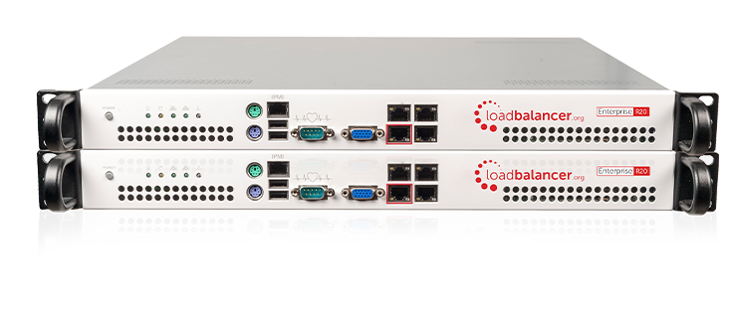
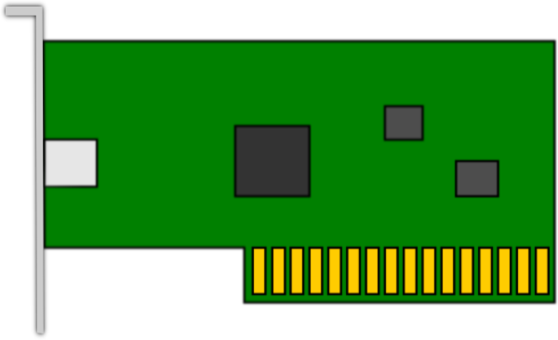
Network Security – Load Balancing
Virtual IP Address
10.10.10.100
NIC 1
NIC 2
172.16.100.10
192.168.123.34
Active
Active
Notes:
Common Address Redundancy Protocol or CARP

Slide 6

Network Security – Load Balancing
NIC 1
NIC 2
Offline
Active
Active
Passive

Slide 7
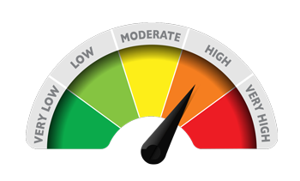
Network Security – Load Balancing Scheduling
Round Robin
NIC 1
NIC 2
Active
Active
Weighted Round Robin

Slide 8

Network Security – Load Balancing Scheduling
Least Connection
NIC 1
NIC 2
Active
Active
Weighted Lease Connection
Not Busy
Connection Heavy

